Slide 1


Risk Management for Projects
Said Fawzy
Section 1:
The fundamentals of risk management

Slide 2
Module Contents
Introduction
Why risk management?
The risk management process
Setting objectives: The Kunda Island scenario

Slide 3
What you will learn in this section
Define risk management
Recognize why it's important to set the context and objectives for the risk management process
Recognize why it's necessary to apply a risk management process in a project, and
Summaries and classify each step of the risk management process by using the Risk Management Canvas.

Slide 4
1 Introduction

Slide 5
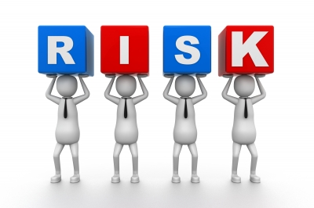
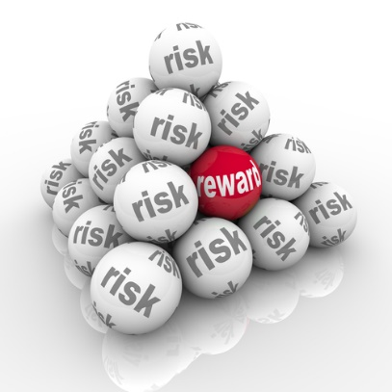



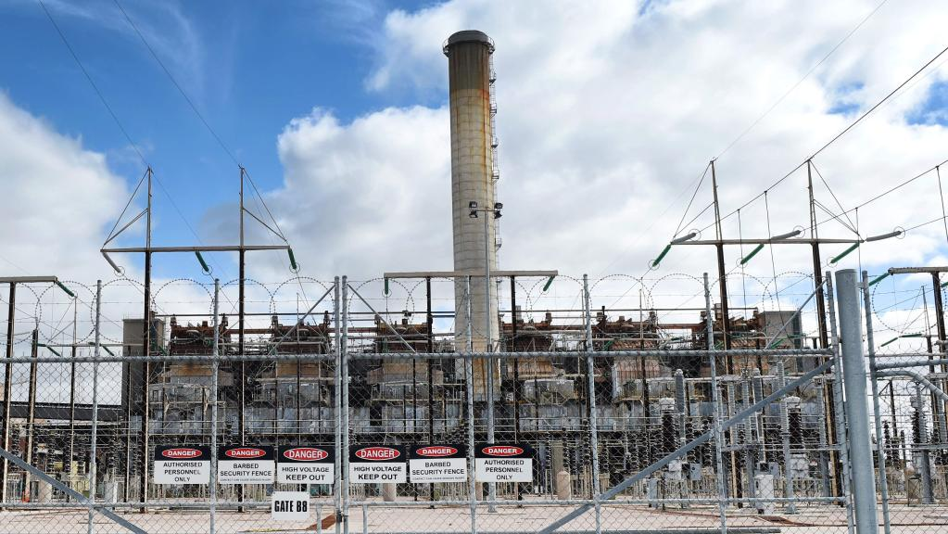

قال ايه اللى رماك على الــ
قلت عشان الـ بتاعه

Slide 6
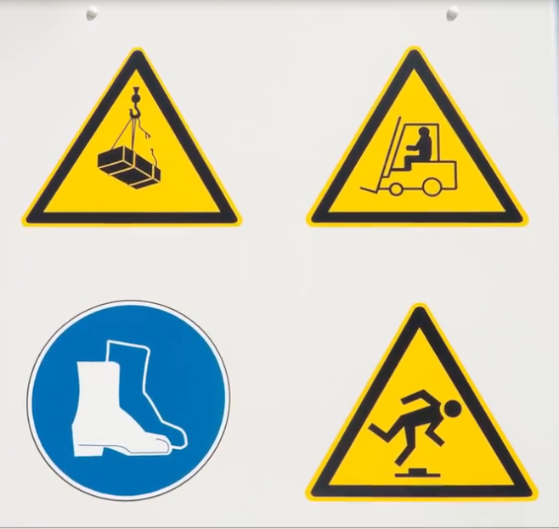
How people think about risk ?

Slide 7
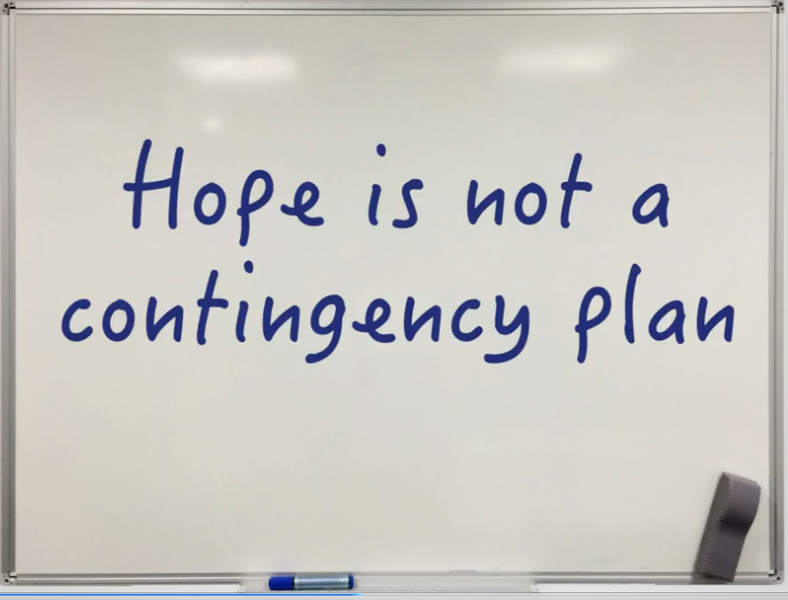
Hope is not a contingency plan

Slide 8
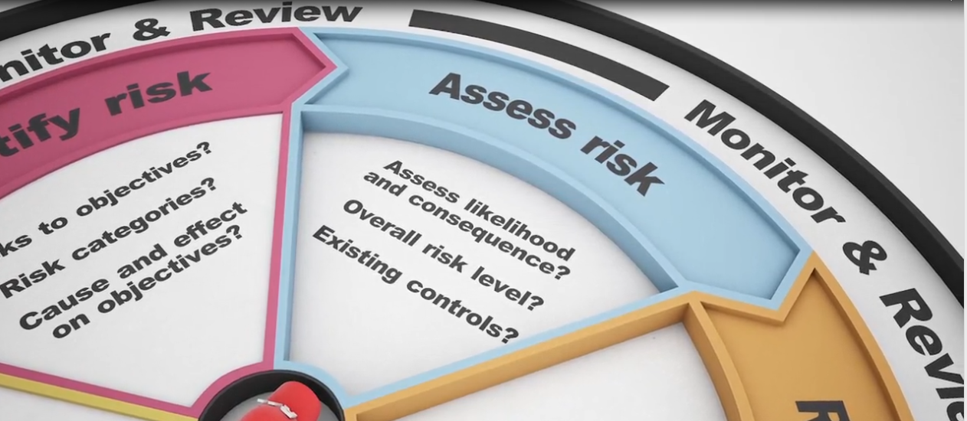
Effective risk management builds confidence

Slide 9
The fallout of not addressing risk
Not every project goes according to plan. Take a moment to examine these images, and then think about what could have been done to anticipate - and even avoid - the outcomes that are evident here.

Slide 10
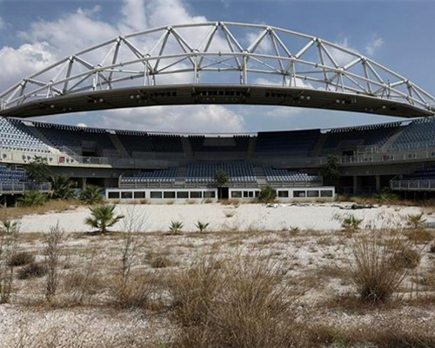
Olympic Stadium, Athens Greece (2016)

Slide 11
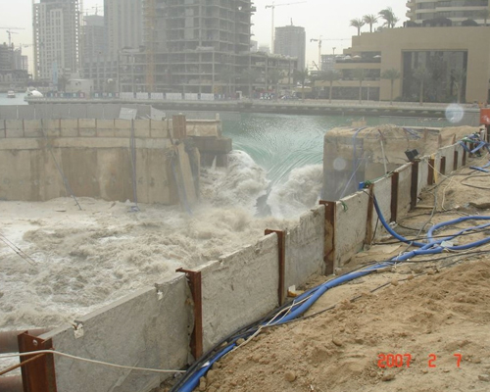
Building construction site, Dubai United Arab Emirates (2007)

Slide 12
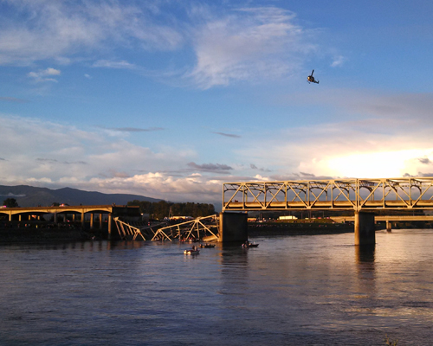
Skagit Bridge, Washington United States of America (2013)

Slide 13
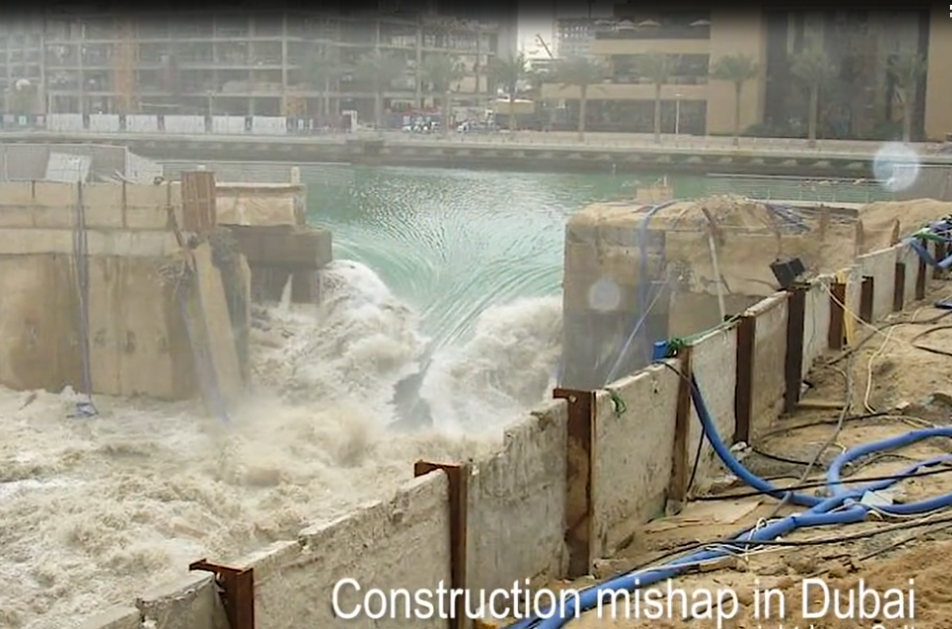
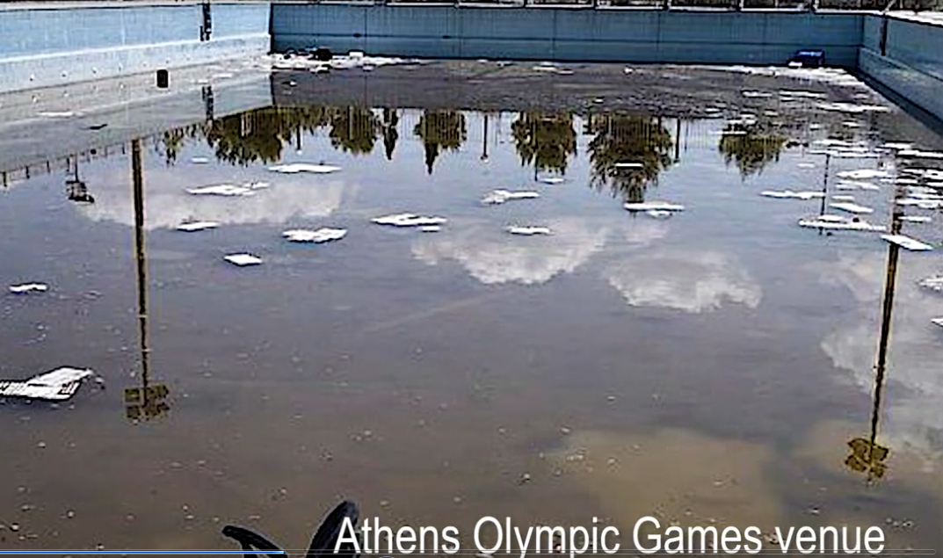
An introduction to risk management

Slide 14
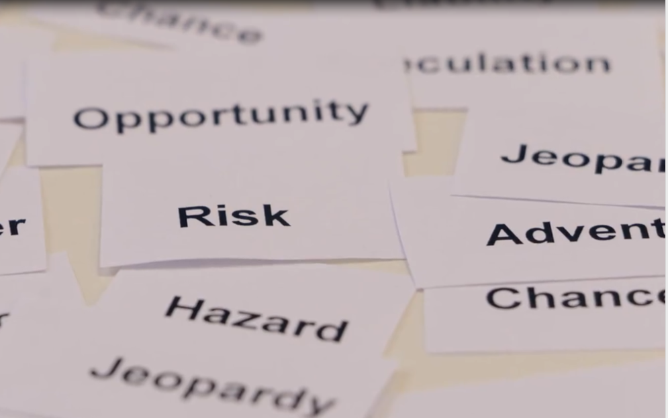
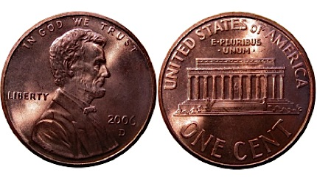
What is risk and what is risk management?
Like a coin risk has two sides .. Negative or positive .
Risk can, therefore, be negative or risk can be positive.
Positive risk is referred to as opportunity.
Both Types emanate from an uncertain event.

Slide 15
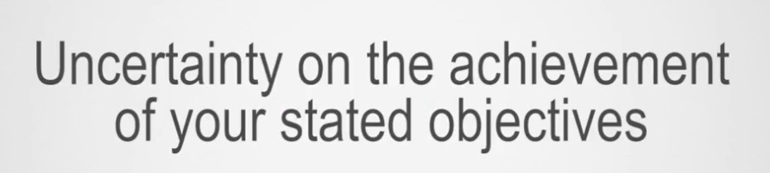
Risk Definition :

Slide 16
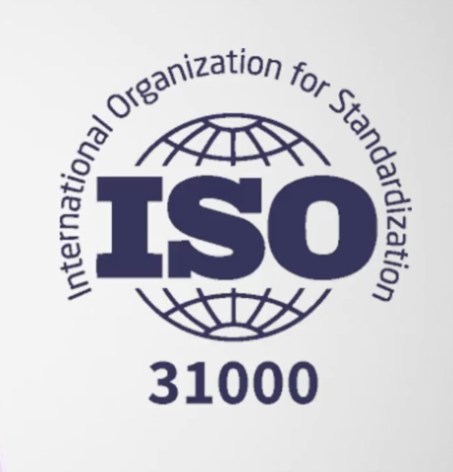
How important is risk management ?
And is anyone actually pay attention to it ?
The answer is the existence of International standard on risk management

Slide 17
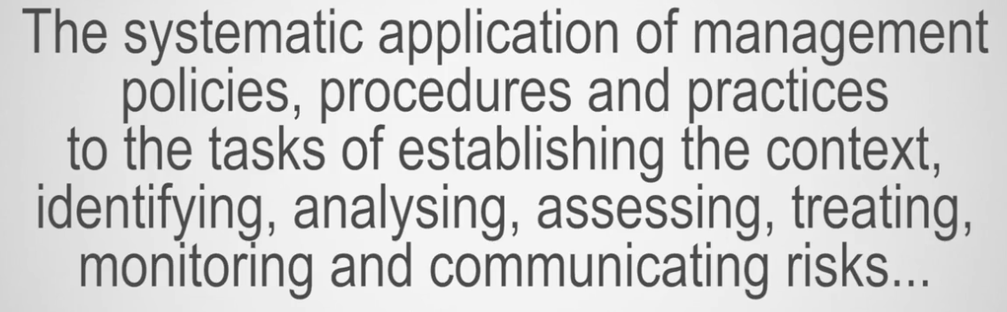
Risk Management definition :

Slide 18
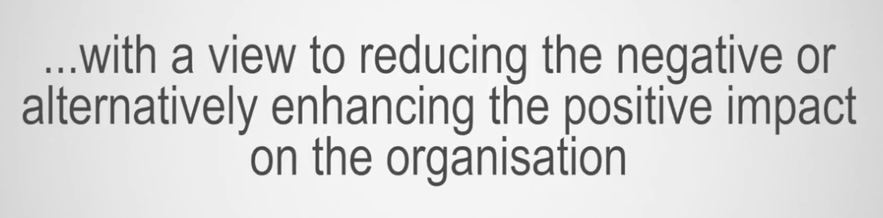
Risk Management definition :

Slide 19
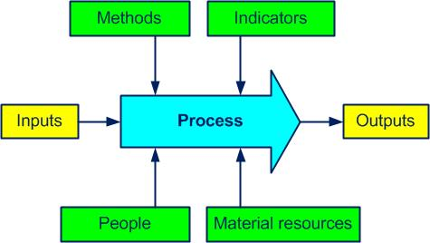
Elements Forms The Risk Management Process
Process Approach Is Important …….. Why ?
Require relationship between elements .
Indicate that risk is a continuous activity

Slide 20
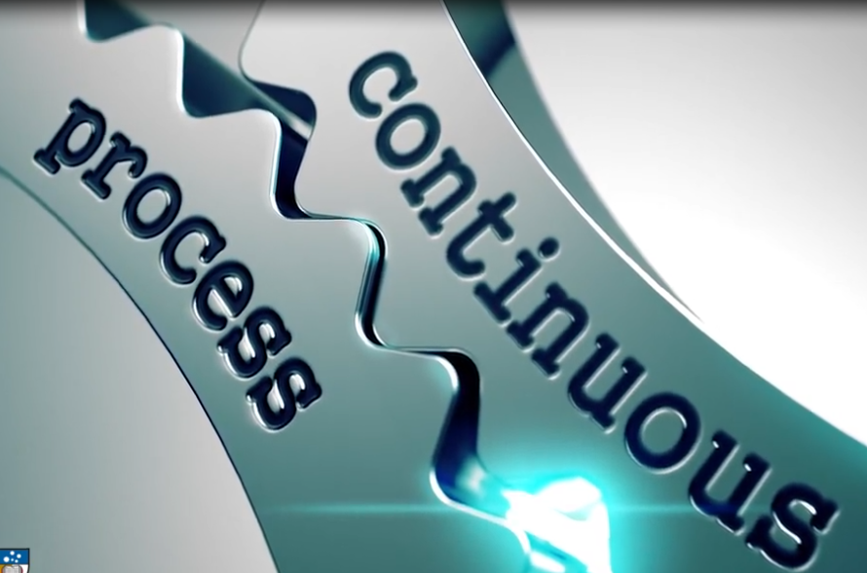
Risk management is a continuous activity, rather than a static event or once-off activity.
Need to take place
at every stage of the project

Slide 21
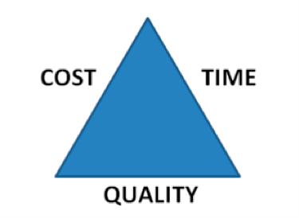
Constant monitoring
Constant monitoring and controlling of uncertainties is part and parcel of ensuring successful project delivery

Slide 22
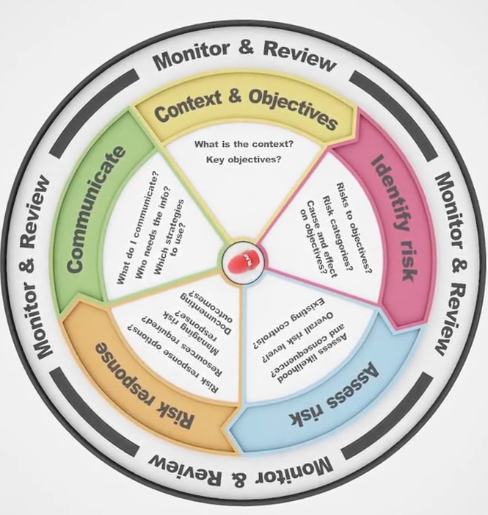
The risk management canvas
Tool

Slide 23
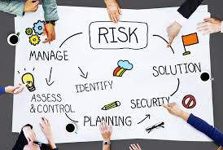
Successful risk management practice
Adoption of Risk manage net regime (such as ISO 31000).
Insuring organization wide application and compliance .
Compliance means commitment that RMP is consistently applied and all elements considered through project life cycle

Slide 24

Error in most organization
The belief that once the RMP has been undertaken, the job is done.
RMP become no more than tick-the-box compliance

Slide 25
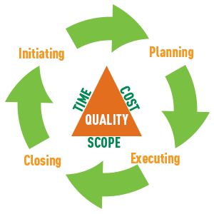
Project life cycle and Complexity
There are high level of uncertainty at outset. (no sufficient data)
When project commences further information becomes available.
The previous assumption changes …..
Creates new uncertainties .
You must revisit and update

Slide 26

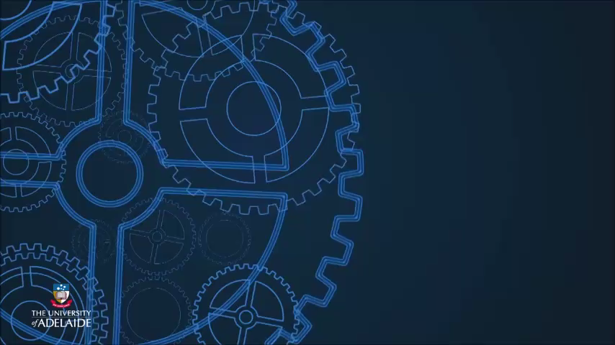
Risk management is a dynamic process
Risk management should therefore be viewed as a dynamic process that is designed to contribute to project or organizational success.
RMP demands continual review and modification to keep up with potential challenges and risks

Slide 27
Knowledge check 1:
The fundamentals

Slide 28

Question 1
In a project setting, whose job includes risk management?
A project manager
A business manager
An entrepreneur
All of the above
Explanation
Risk management is undertaken by anyone working on a project (or in an organisation), who is responsible for ensuring objectives are met.

Slide 29
Question 2
What is the source - or origin - of a risk?
A certain future event
An uncertain future event
A new manager
Loss of profit
Explanation
All risks derive from the uncertain future events that may occur within a project or organisation.

Slide 30
Question 3
Is this statement true or false? Risk only identifies the negative future events within a project or organisation.
True
False
Explanation
Risk can be positive or negative. While negative risk concerns itself with harm, injury, loss of profit and even death, positive risk identifies potential opportunities.

Slide 31
Question 4
Which of the following definitions most accurately describes risk?
Risk is the uncertainty on the achievement of your objectives
Risk is the plan implemented to achieve your objectives
Risk is the resources and tasks undertaken to achieve your objectives
Risk is unknown and can never be anticipated
Explanation
Risk deals with uncertainty. Therefore, when we examine the word 'risk', we are considering those uncertainties that may impact how we achieve our objectives within a project or organisation.

Slide 32
Question 5
What is risk management?
A philosophy
A plan
A project
A process
Explanation
Risk management is a systematic process that is applied to identify, assess and treat risks. It is done continuously throughout a project's life cycle, and is an iterative process that requires constant monitor and review.

Slide 33
2-Why risk management?

Slide 34
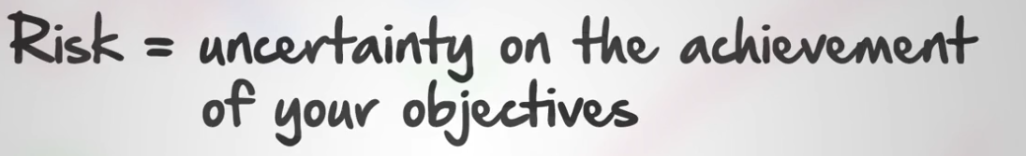
Risk :
Review

Slide 35
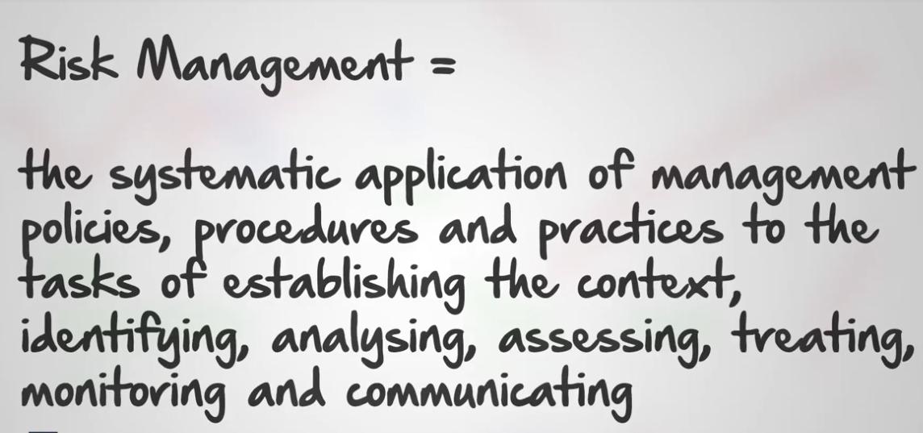
Risk Management:
Review

Slide 36
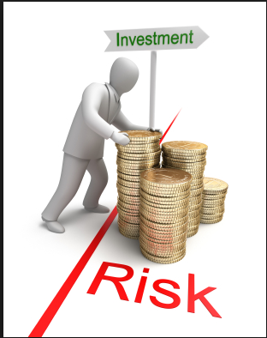
Why do we need to consider risk management?
Two main drivers why organizations devote time, money, and effort to the development and maintenance of their risk management regimes:

Slide 37
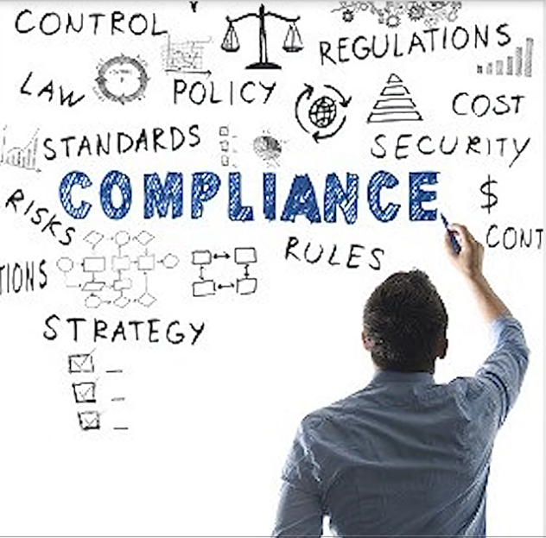
what the purpose of risk management is?
1-The first is for legislative compliance reasons,

Slide 38

what the purpose of risk management is?
2- risk management is now considered to be part of good management practice.
Outcomes is used to inform Management decision making

Slide 39
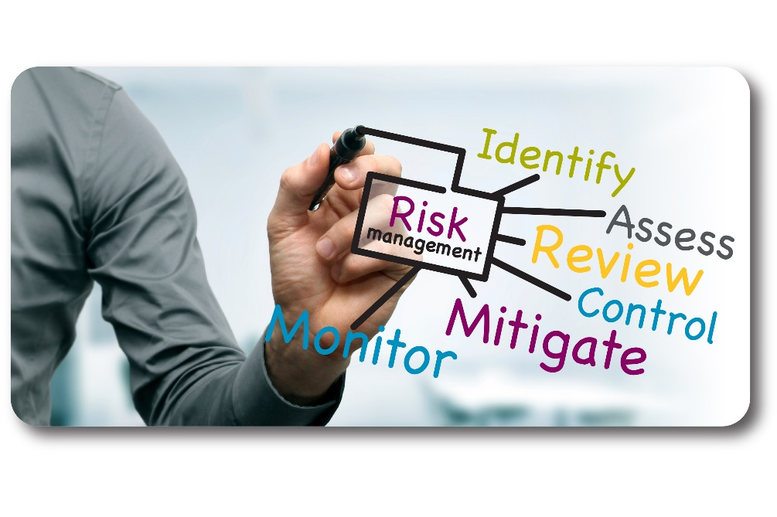
Why Risk Management ?
the most important activity or part of the project management planning process.
project managers are able to consider risk to their project objectives before project begin.
They can identify, analyze, and assess, and finally develop appropriate responses to these risks.
A key purpose of risk management is to identify potential opportunities or problems before they occur.

Slide 40

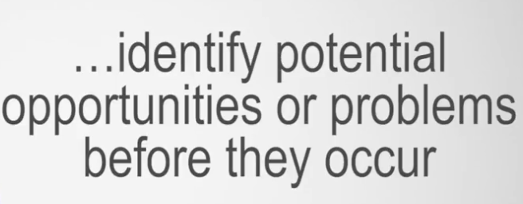
Key Purpose of Risk management:

Slide 41
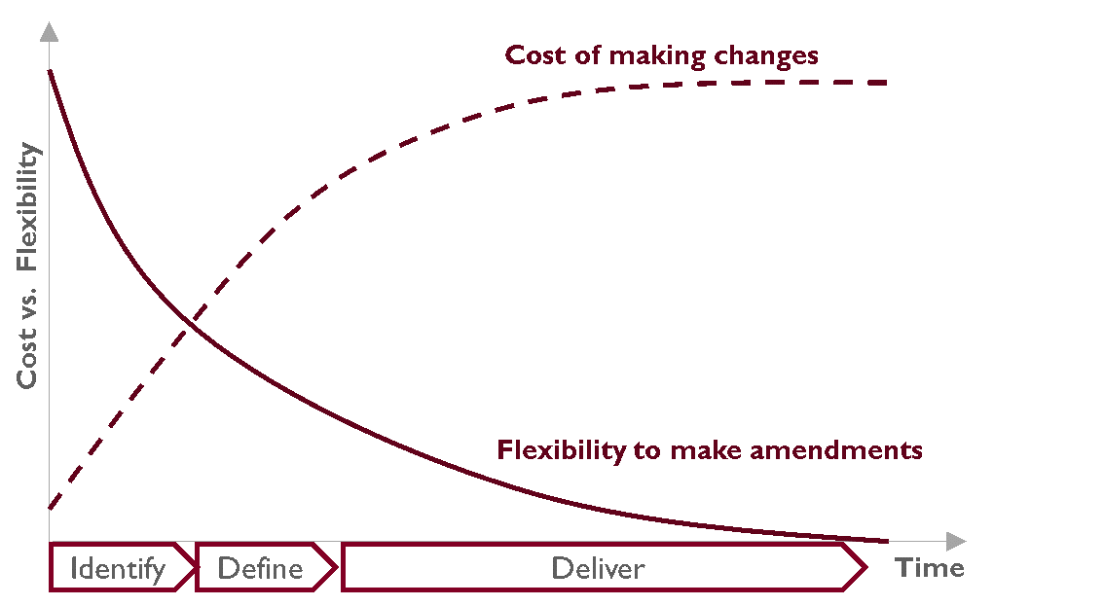
Why Early Risk Plan ?
easier, less costly, and far less disruptive to make changes and review prior decisions during the earlier phases of the project.

Slide 42
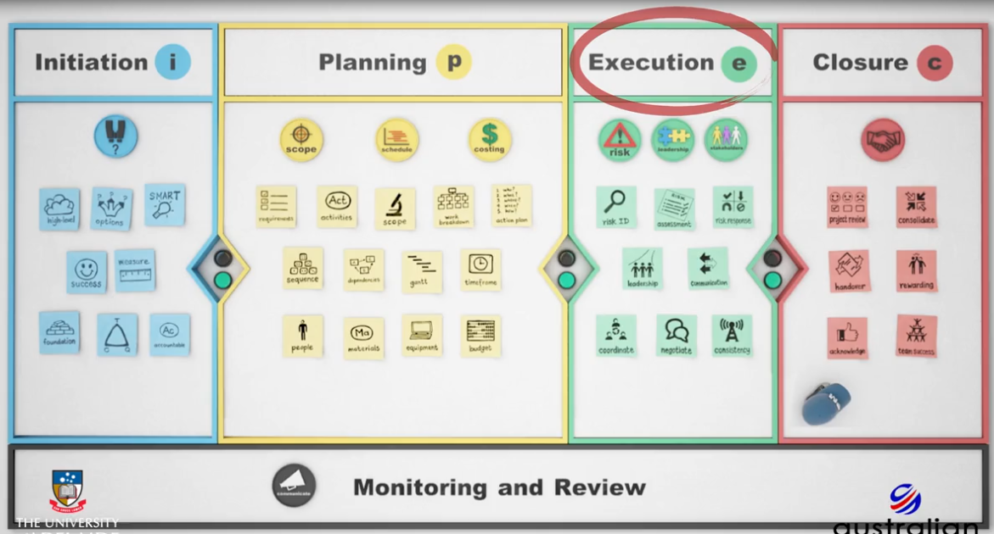
Unforeseen risk may trigger in execution faze.
Without effective risk management processes in place, you may move to the execution phase and an unforeseen risk may trigger.

Slide 43
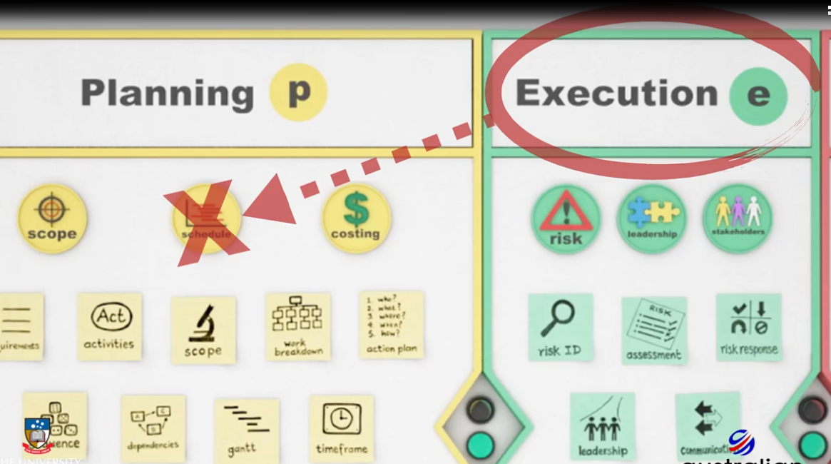
Unforeseen risk may trigger in execution faze.
you may only then find out that your schedule is not realistic, your budget comes under pressure, or your quality is below par

Slide 44
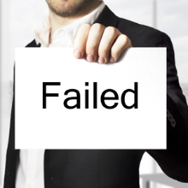
Unsuccessful projects Review
In reviewing a number of unsuccessful projects, it has been found that projects were often rushed into the execution phase.
Project risks were either not considered, or alternatively were identified and analyzed in a random brainstorming fashion without a coherent plan and process in place.

Slide 45

Even with thorough risk management planning in executing your project, you may still encounter unexpected or unanticipated risks that have to be dealt with on an emergency type basis

Slide 46
Knowledge check 2:
The fundamentals

Slide 47
Question 6
Which of the following is a reason to undertake risk management? Identify each valid reason.
Legislative compliance
Good management practice
Identifying potential opportunities and challenges
Developing team support
Explanation
Developing team support is not a reason to undertake risk management. Team support may develop throughout the process, but is not a reason to undertake the risk management process.

Slide 48
Question 7
Which of the following identifies the 3 critical success factors in projects that will help you to identify and assess risks?
Scope, cost and quality
Time, scope and cost
Cost, quality and scope
Time, cost and quality
Explanation
These are the 3 main criteria that determine the success of a project. Within these areas, risks will need to be identified, assessed, and responded to appropriately.

Slide 49
Question 8
Although the risk management process is continuous, during which phase of the project life cycle should risk management occur?
Initiation
Planning
Execution
Closure
Explanation
Risk management should occur before the project is executed and, therefore, takes place in the Planning stage of the project's life cycle.

Slide 50
3-The risk
management process

Slide 51
The risk management process
The risk management process should be applied as early as possible in the project life cycle, so that risks are identified, assessed, and appropriate responses developed before moving to execution.

Slide 52
The risk management Canvas:
Our risk management canvas has six segments. Each segment represents a stage of risk management.
The monitor and review stage is shown as a continuous activity throughout the process

Slide 53

Risk management canvas

Slide 54
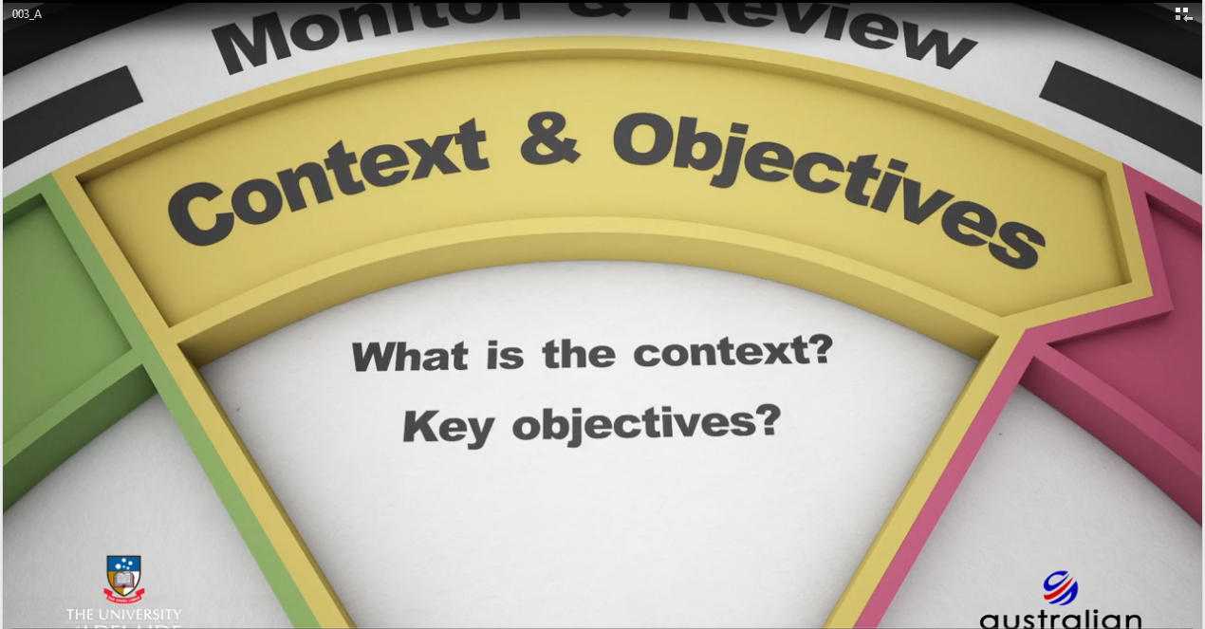
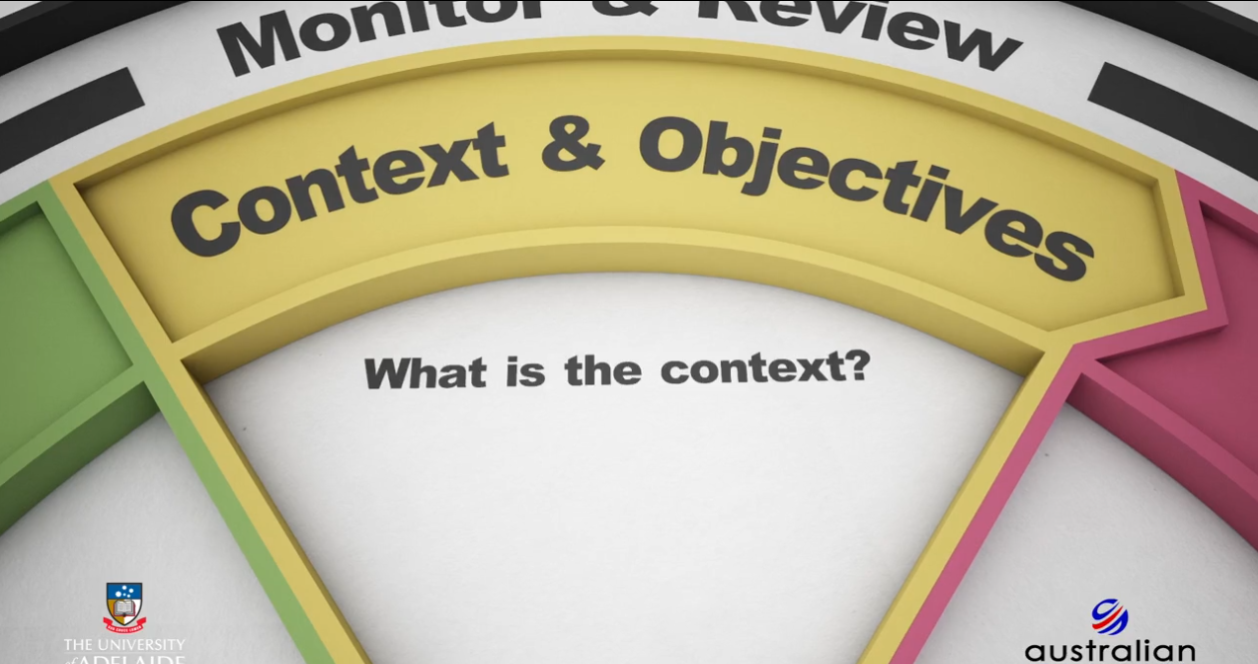
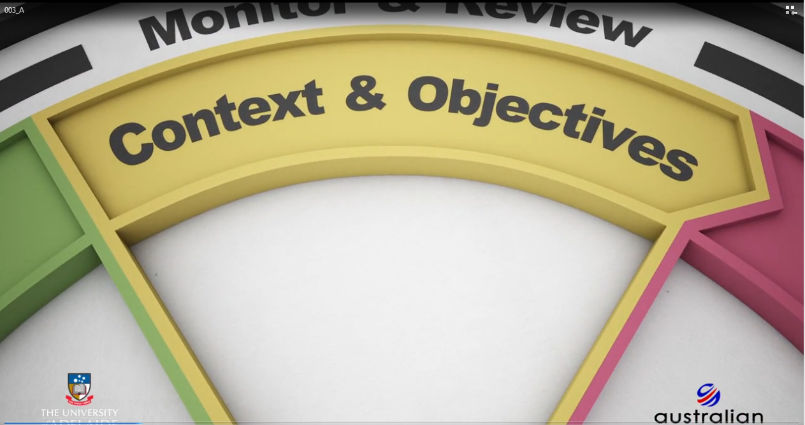
1-Context & Objectives

Slide 55
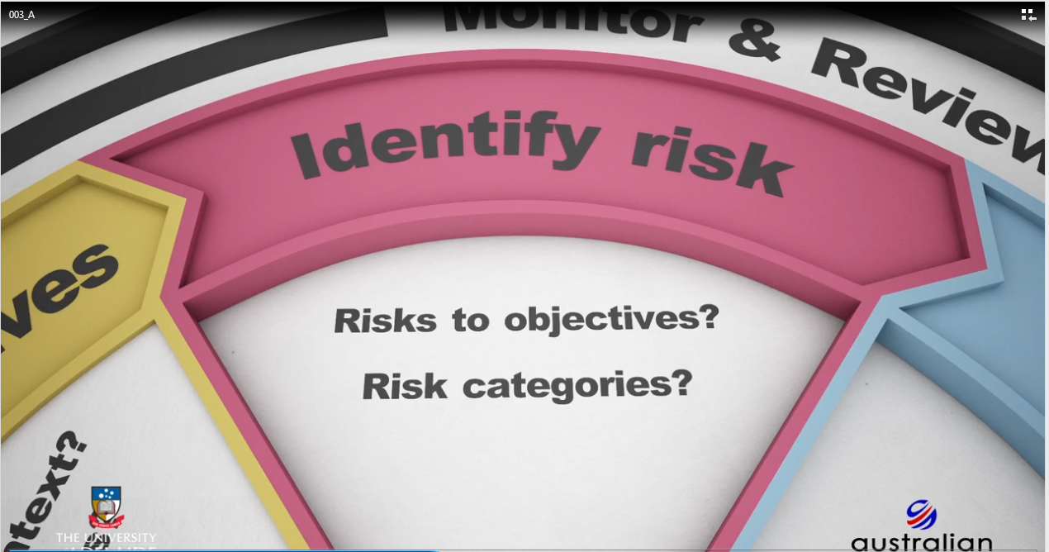
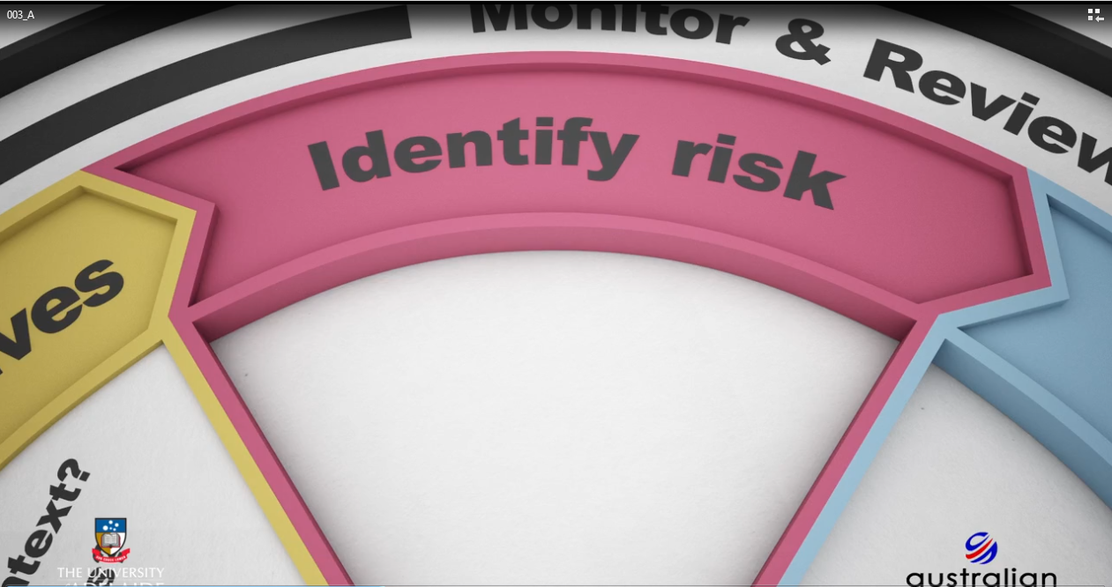
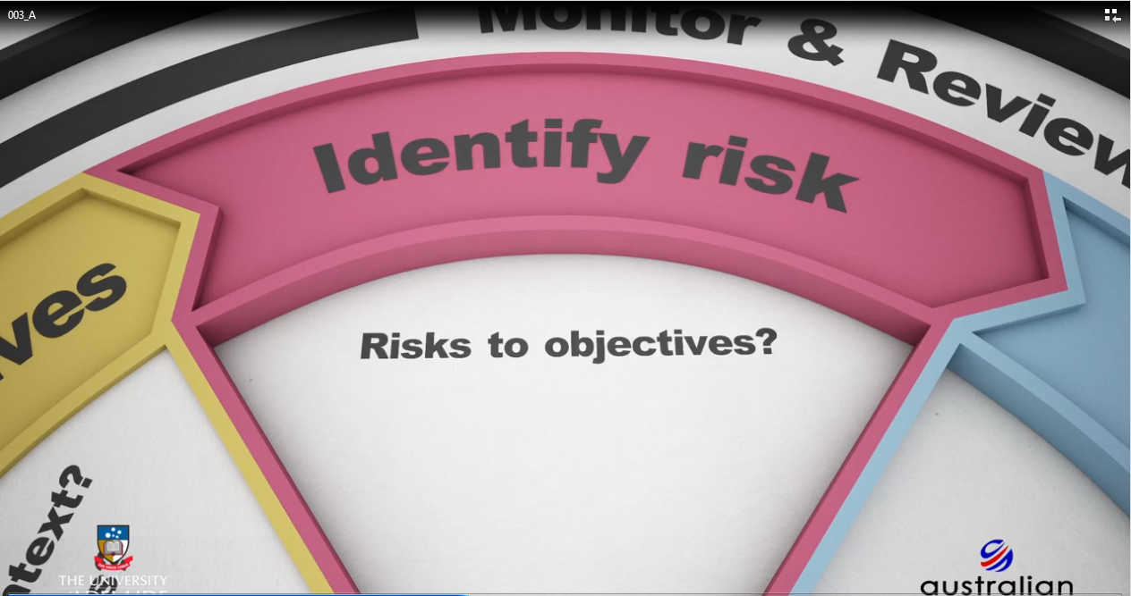
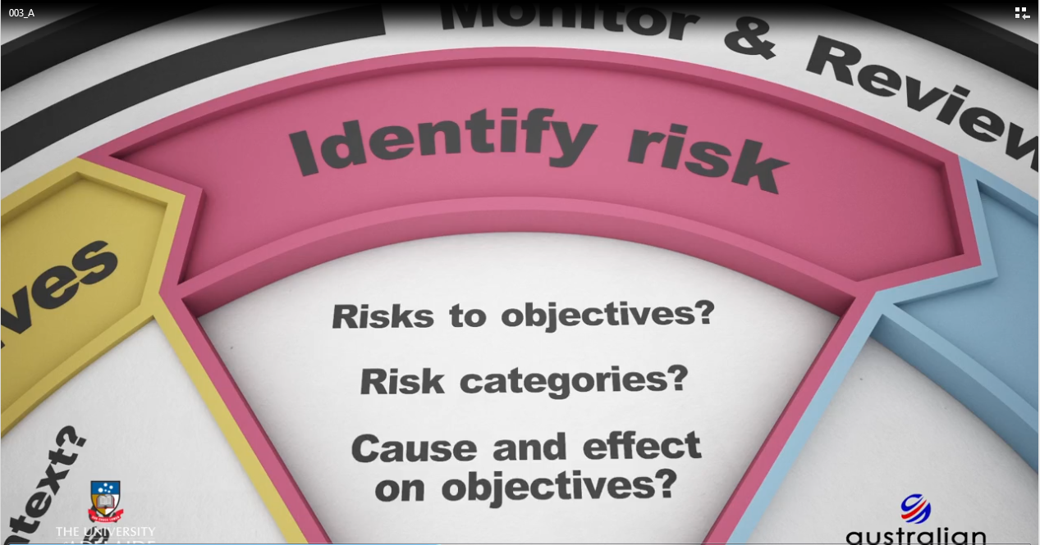
2-Risk Identification:

Slide 56
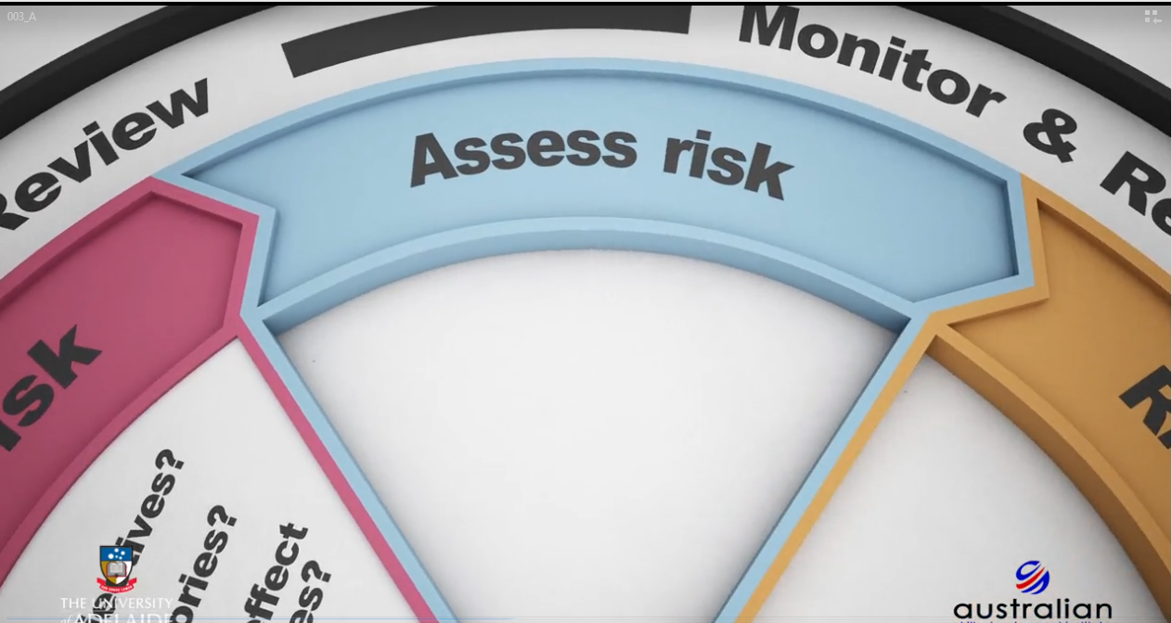
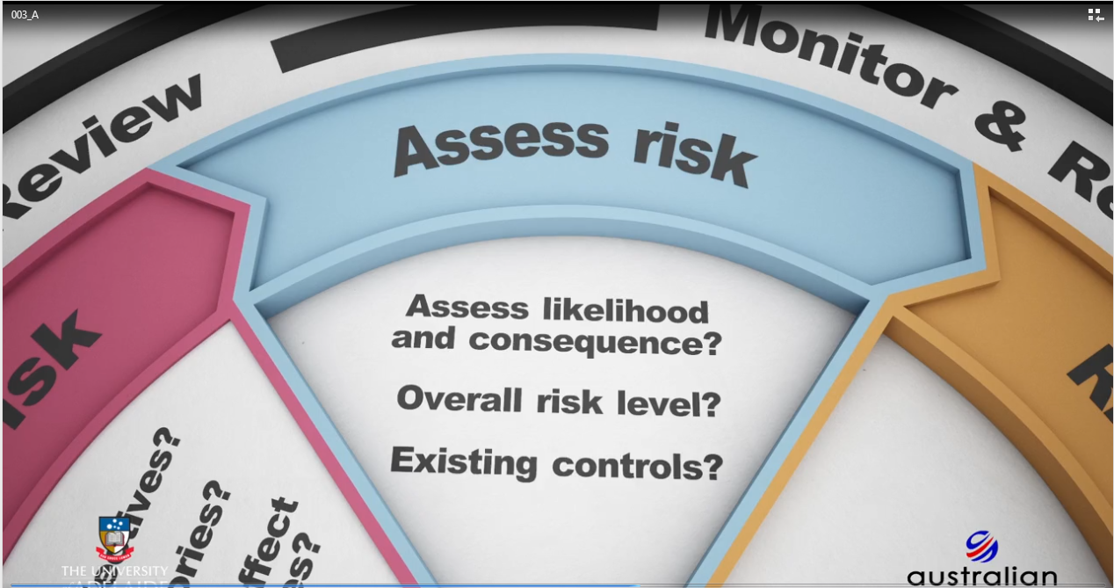
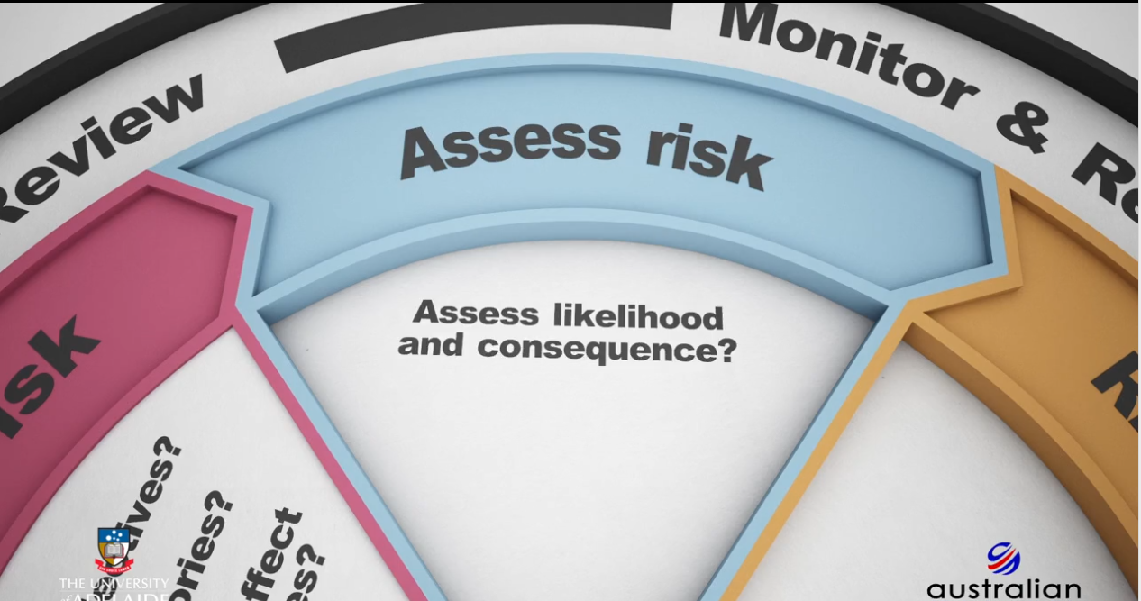
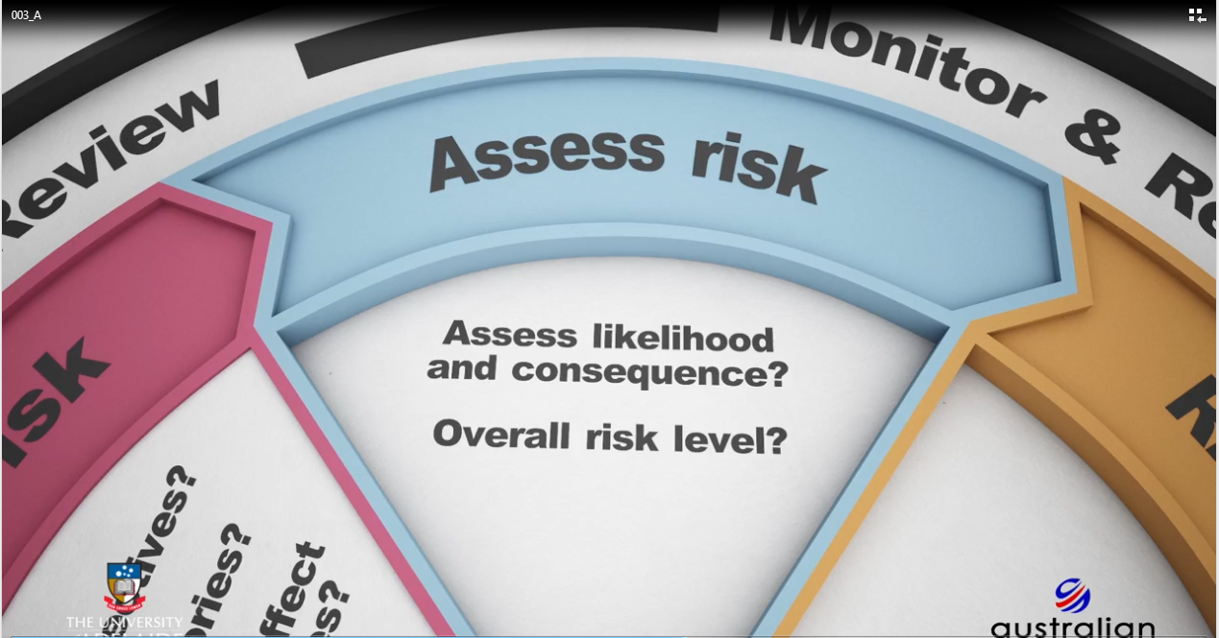
Assess Risk

Slide 57
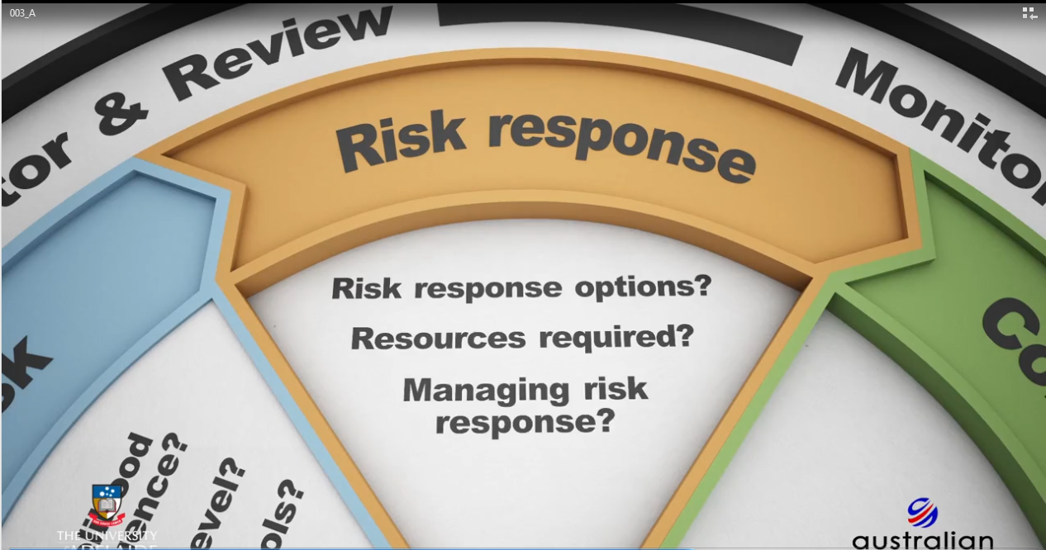
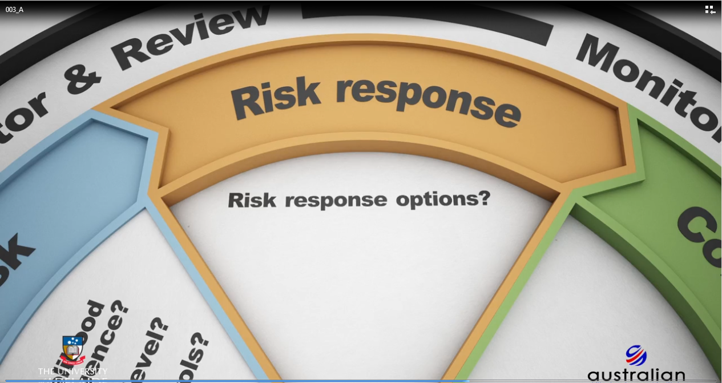

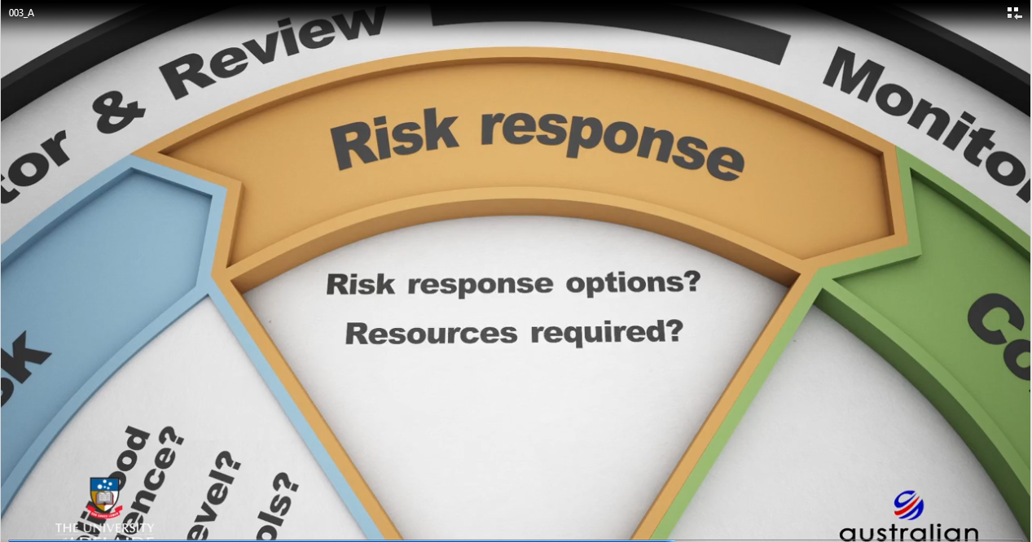
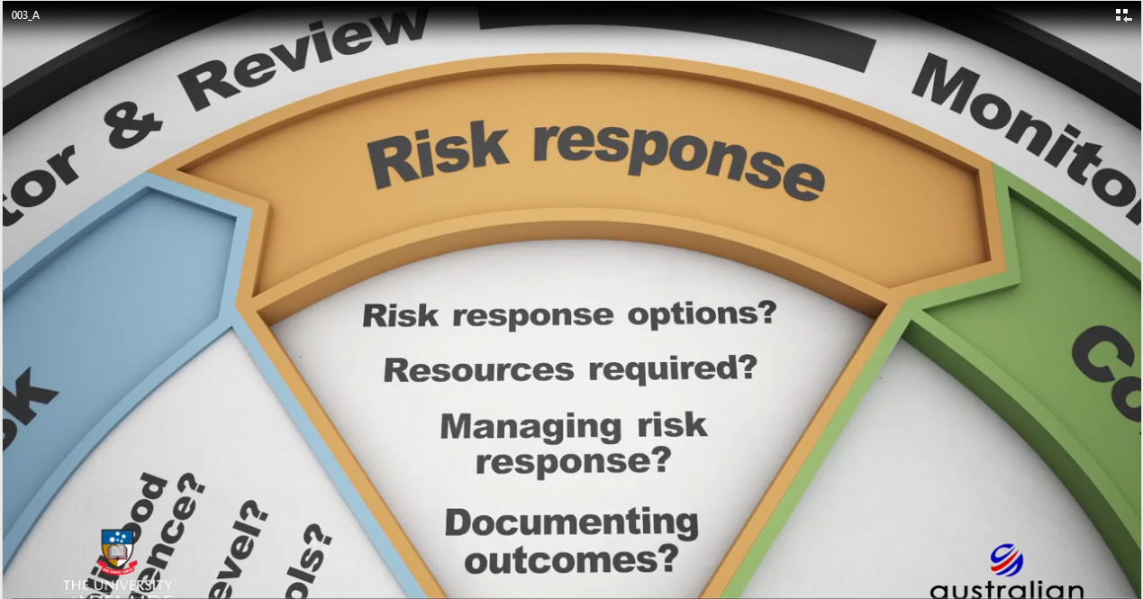
Risk Response

Slide 58
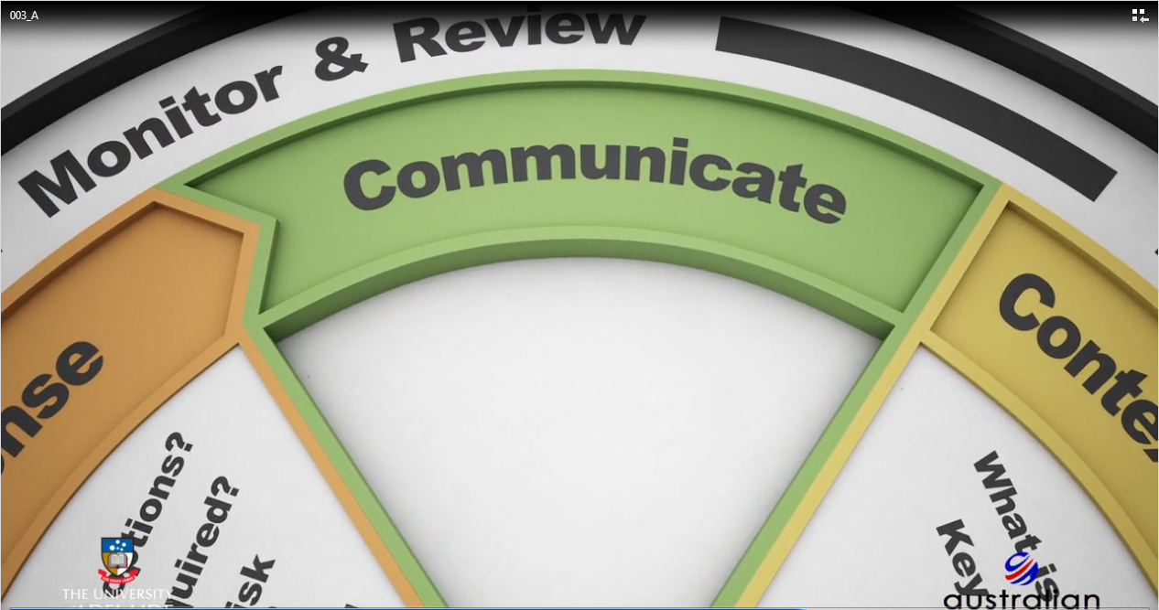



Communicate :

Slide 59










Monitor and Review :

Slide 60
Knowledge check 3:
The fundamentals

Slide 61
Question 9
What is the correct order of the stages of the risk management process?
1. Context and objectives 2. Risk identification 3. Risk assessment 4. Risk response 5. Communication 6. Monitor and review
1. Context and objectives 2. Communication 3. Risk identification 4. Risk assessment 5. Risk response 6. Monitor and review
1. Context and objectives 2. Risk identification 3. Risk assessment 4. Communication 5. Risk response 6. Monitor and review
1. Context and objectives 2. Risk identification 3. Communication 4. Risk assessment 5. Risk response 6. Monitor and review
Explanation
The risk management process contains 5 main stages, with the stage of Monitor and review seen as a continuous process throughout.

Slide 62
Question 10
What does setting the context and objectives in the risk management process clarify?
The context of the stakeholders, and the objectives that they need to achieve within the project
The context within which the risk management process is applied, and the objectives that stakeholders need to achieve
The context in which the risk management process is applied, and the objectives of the project that need to be achieved.
The context within which the risk management process is applied, and the objectives of the project manager
Explanation
Setting of the context and objectives of the project provides information on the context of the project that risk management needs to address. It further clarifies the objectives that the project needs to achieve.

Slide 63
Question 11
Who is responsible for identifying risks?
The project manager and project sponsor
The project manager, project team, and stakeholders
The project sponsor and project team
The project sponsor and stakeholders
Explanation
Risk identification is undertaken by the project manager, project team and stakeholders to ensure all risks are properly identified.

Slide 64
Question 12
What are key considerations for assessing risks effectively? Identify each key consideration.
Likelihood
Response
Consequence
Impact
All of the above
Explanation
responses in assessing risks effectively to determine the likelihood (in other words, the probability) of the risk occurring, and the subsequent consequence should that risk occur.

Slide 65
Question 13
What actions are involved in the risk response stage?
Accepting risks
Minimising risks
Maximising opportunities
All of the above
Explanation
Responding to risk adopts a set of actions that you can apply to ensure that you minimise risks, leverage and maximise opportunities through positive risk, and accept risks.

Slide 66
Question 14
Communication about risks is the most important stage of the risk management process. Which of the following descriptions accurately reflect the communication stage?
It should be informal
It should be formal
It should be regular
It should be ad-hoc
Explanation
Since communication is required throughout the risk management process, it should occur formally and regularly to ensure that all stakeholders have the most accurate and up-to-date information on identified risks and risk response decisions.

Slide 67
4-Setting objectives:
The Kunda Island scenario

Slide 68

The Kunda Island scenario
The following animation is set on Kunda Island, which is a place that does not exist, and features characters that also do not exist.
When you have finished watching this scenario, answer the question below.
The Kunda Island scenario will be referred to throughout the course.

Slide 69


Slide 70


Slide 71


Slide 72
The Kunda Island scenario question
What objective should have been set to deal with the brown snake issue in the Kunda Island scenario?
Reduce the number of snake deaths from snakebites
Introduce a new species to kill the brown snake
Give each person on the island a gun
Move everyone to another island
None of the above
Explanation
The Kunda Island Council will revise their objective. The new objective will be revealed in Section 2. Come back to see if the decision is the same as yours.

Slide 73
Discussion: Effective risk management
Considering the aspects of effective risk management that you have learnt about in this section, we'd like you to think about how effective your organization (or an organization you have worked for previously) is at undertaking effective risk management.

Slide 74
5 FAQ

Slide 75
FAQ :
I quite often hear the comment, "...but as a project manager we won't have enough time to stop and think about risk."

Slide 76
FAQ :
2.Commonly held belief is that risk management in projects is all about ensuring things don't go wrong on the project.

Slide 77
FAQ :
3."OK, I understand that risk management is important in a project context, and that it has two elements to it. But when in the life of my project should I actually start to apply the risk management process?"

Slide 78
Feed back

